Slide 1
UZV dijagnostika u reprodukcijskoj medicini
Albert Despot

Slide 2
Trodimenzionalni ultrazvuk
Volume Contrast Imaging - VCI
Tomographic Ultrasound Imaging – TUI
OmniView – curve, polyline
SonoAVC
GE Healthcare ultrasound technology

Slide 3
The Actors of Human Implantation:
Gametes, Embryo, Endometrium
3-D ultrasonography with vocal analysis may inform on the uterine preparation to a constructive dialogue with conceptus through an adequate trophicity and angiogenesis. This point of echographic evaluation opens up new horizons for the evaluation of the endometrium, well beyond the simple measurement of the thickness that improperly corelate with outcome of IVF, since without absolute cutoff.
Virginie Gridelet et al.
University of Liege
Belgium

Slide 4
MECHANISMS OF IMPLANTATION: STRATEGIES OF SUCCESSFUL PREGNANCY
About 75% of failed pregnancies from fertilization to parturition are considered to be due to implantation failure
Division of Reproductive Sciences, Perinatal Institute, Cincinnati Children's Hospital Medical Center, University of Cincinnati College of Medicine, Cincinnati, Ohio, USA.
  Jeeyeon Cha,
  Xiaofei Sun &
  Sudhansu K Dey

Slide 5
The Actors of Human Implantation:
Gametes, Embryo, Endometrium
In practice less than 5% of oocytes colected in vitro fertilization (IVF) cycles and only 20 to 25% of embryos transferred lead to birth and take-home baby.
Virginie Gridelet et al.
University of Liege
Belgium

Slide 6
The Actors of Human Implantation:
Gametes, Embryo, Endometrium
The success of pregnancy depends of receptive endometrium, a normal blastocyst, a synchronized cross-talk at the maternal- fetal interface at the time of implantation, and finally a successeful plancetation and remodeling of uterine vasculature.
Virginie Gridelet et al.
University of Liege
Belgium

Slide 7
The Actors of Human Implantation:
Gametes, Embryo, Endometrium
The window of implatation is a limited time span when blastocyst competency is superimposed on the receptive state of uterus.
The window of receptivity is transient in humans, and implatation beyond this window results in:
spontaneous miscarriages
preeclampsia
preterm birth
Virginie Gridelet et al.
University of Liege
Belgium

Slide 8
The Actors of Human Implantation:
Gametes, Embryo, Endometrium
Implantation process is not easily accessible in vivo to
research for obvious ethical and tehnical reasons.
The only way to evaluate it is to extend data derived from:
Animal studies
In vivo endometrium studies (ultrasound ... etc)
Embryo separatly studies
In vitro endometrium – early blastocyst culture
Virginie Gridelet et al.
University of Liege
Belgium

Slide 9
The Actors of Human Implantation:
Gametes, Embryo, Endometrium
Despite extensive research in this field,
the implantation process remains the black box of
the reproduction, even in 2013.
Virginie Gridelet et al.
University of Liege
Belgium

Slide 10
Normal thickness of uterine lining
During menstruation: 2-4 mm
Early proliferative phase: 5-7 mm
Preovulatory phase: up to 11 mm
Secretory phase: 7-16 mm
Postmenopause: up to 5 mm
2D measurements

Slide 11
Za implataciju iz „in vivo“ ili „in vitro“ fertilizacije potrebna je idealna anatomija i fiziologija:
Sekrecijski promjenjenog endometrija
Miometrija
Uterinog protoka

Slide 12
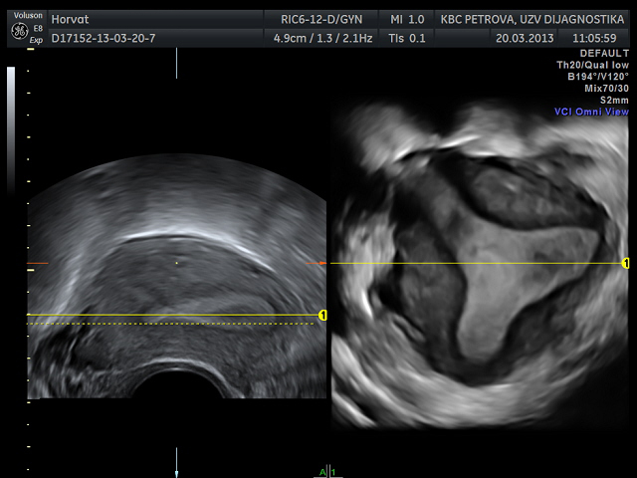
Endometrij u dvodimenzionalnom i trodimenzionalnom ultrazvučnom prikazu
2D - uzdužno
3D - koronarno

Slide 13
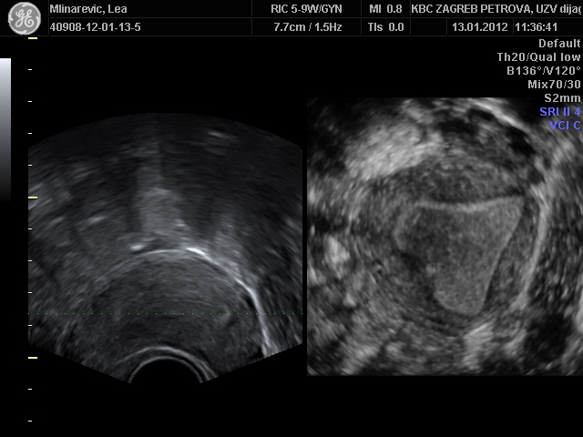
Endometrij u dvodimenzionalnom i trodimenzionalnom ultrazvučnom prikazu
2D - uzdužno
3D - koronarno

Slide 14
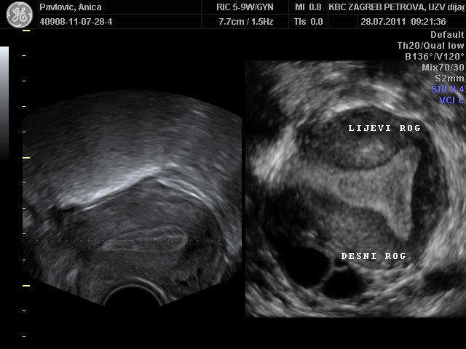
Koronarni presjek endometrija

Slide 15
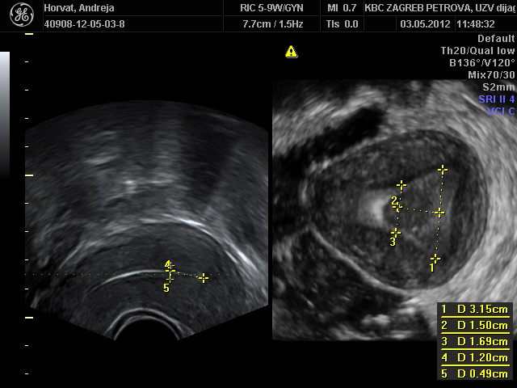
Volumen “implatacijskog” endometrija
a
l
c

Slide 16
Volumen “implatacijskog” endometrija
d....debljina endometrija u uzdužnom
presjeku (2D)
P_{c}...površina endometrija u koronarnom
presjeku (3D) – jednakokračni trapez
l = konstanta: 1,5cm

Slide 17
Energetski potencijal implatacijskog endometrija
E_{ATP} = M_{guk} x 36
EATP = Vie x Cguk(mm³) x 36
Mguk = masa glukoze
Mguk = Vie x Cguk(mm³)
(3D UZV)
C_{guk(mm}3₎ = koncetracija glukoze u mol/mm³ i.e.
1 mol. guk. = 36 ATP

Slide 18
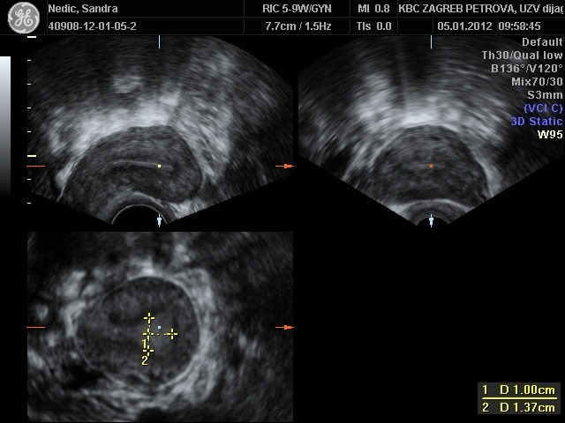
Sterilitet - 43. god. - 18. dan ciklusa
Stanje poslije 8 x IVF
V_{ie} = cca 660 mm³

Slide 19
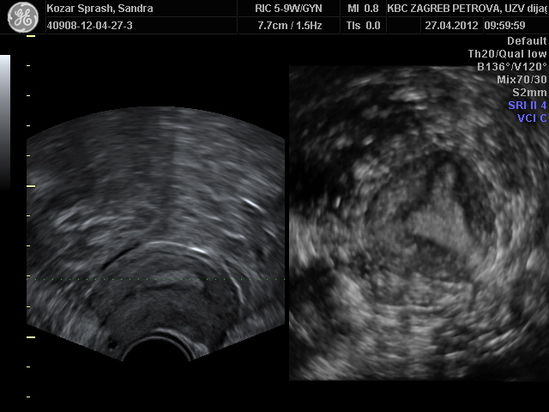
Sterilitet - 39 god. - 20. dan MC
Stanje poslije 5 x IVF
V_{ie} = cca 760 mm³

Slide 20
Mullerian anomalies classification
Class I – Mullerian agenesis
Class II – Unicornuate uterus 20%
Class III – Uterus didelphys 5%
Class IV - Bicornuate uterus 10%
Class V – Septate uterus 55%
Class VI – Arcuate uterus
Class VII - DES uterus
Human Reproduction Update
2011; 17(6): 761-771

Slide 21
Chan YY, Jayprakasan K, Zamora J, Thornton JG,
Raine-Fenning N, Coomarasamy A
The prevalence of congenital uterine anomalies in
unselected and high-risk population: a systematic review
Human Reproduction Update
2011; 17(6): 761-771

Slide 22
Human Reproduction Update
2011; 17(6): 761-771
Opća populacija 5.5%
Infertilitet 8.0%
Spontani pobačaji 13.3%
Habitualni pobačaji 24.5%
94 studije
89861 žena

Slide 23
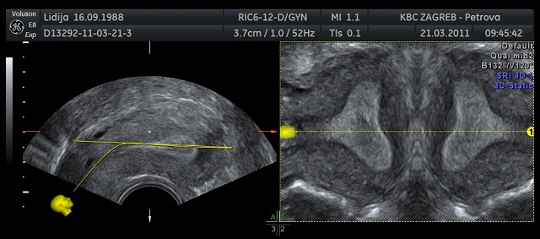
OmniView trace
Ultrasound art
Uterus – 2D
Uterus – 3D

Slide 24
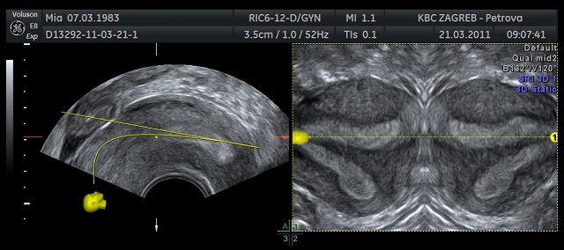
OmniView trace
Septate uterus
Ultrasound art
Uterus – 2D
Uterus – 3D

Slide 25
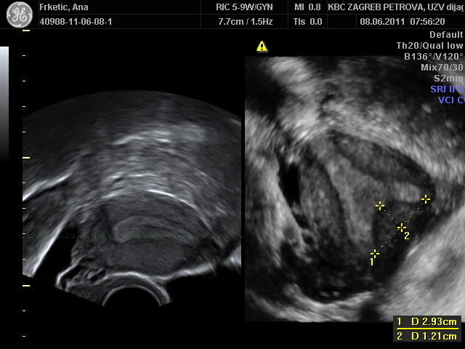
Uterus septatus
12.1 : 29.3 = 0.41 = 41% = septum uteri

Slide 26
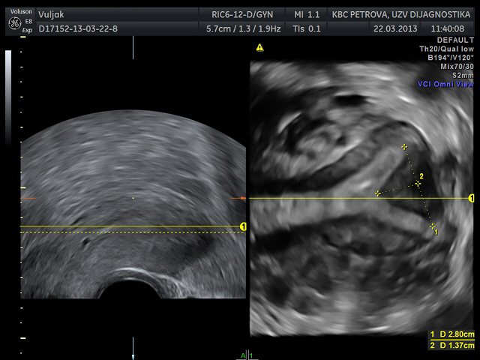
Incomplete uterine septum
13.7 : 28 = 0.4892 = 48.92%

Slide 27
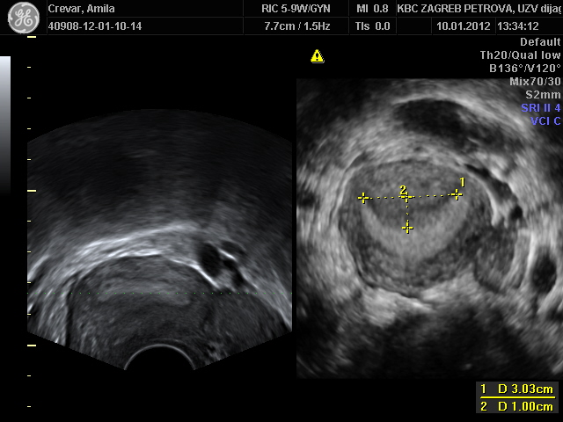
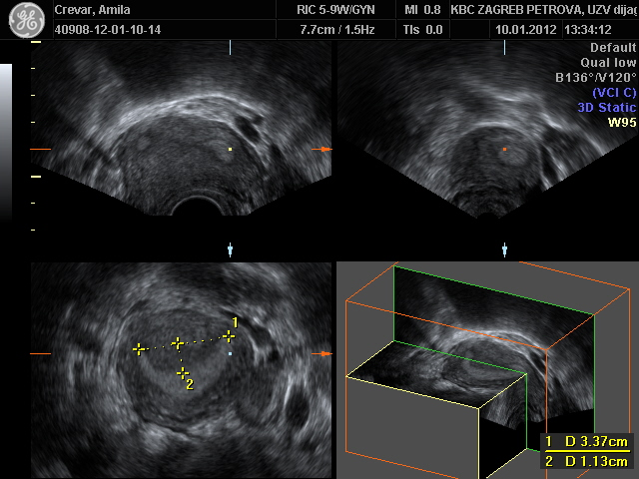
Septum uteri VCI
10 : 30.3 = 0.33 = 33%
11.3 : 33.7= 0.335 = 33.5%
Septum 3D classic

Slide 28
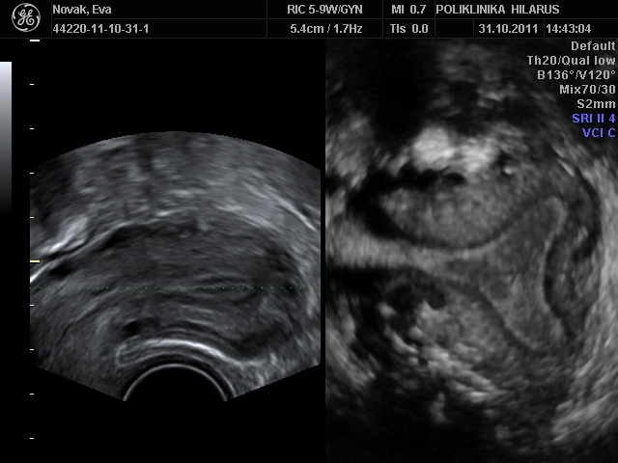
Uterus bicornis

Slide 29
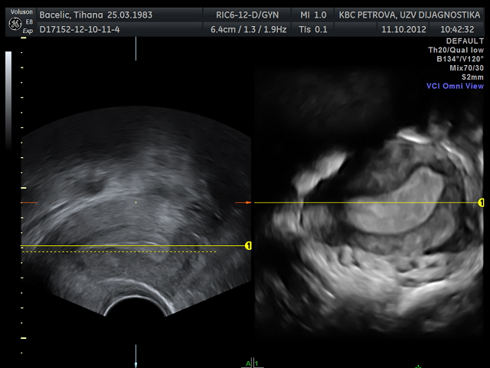
Unicornuate uterus
2D
VCI

Slide 30
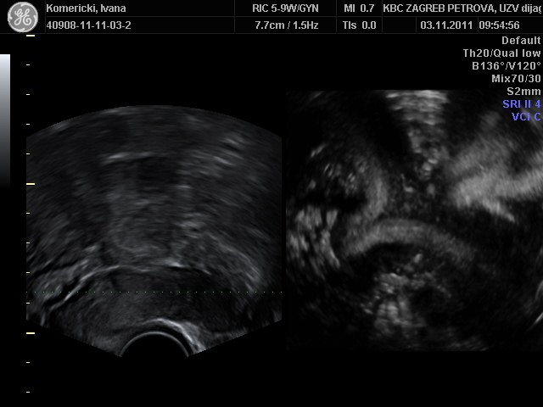
Uterus didelphys
2D
3D

Slide 31
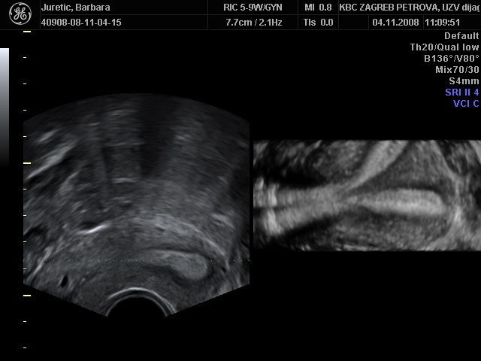
Complete uterine septum

Slide 32
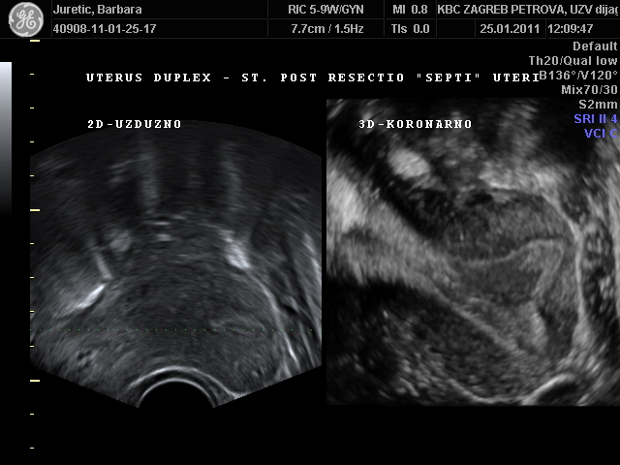
St. post op. septi uteri
Complete uterine septum

Slide 33
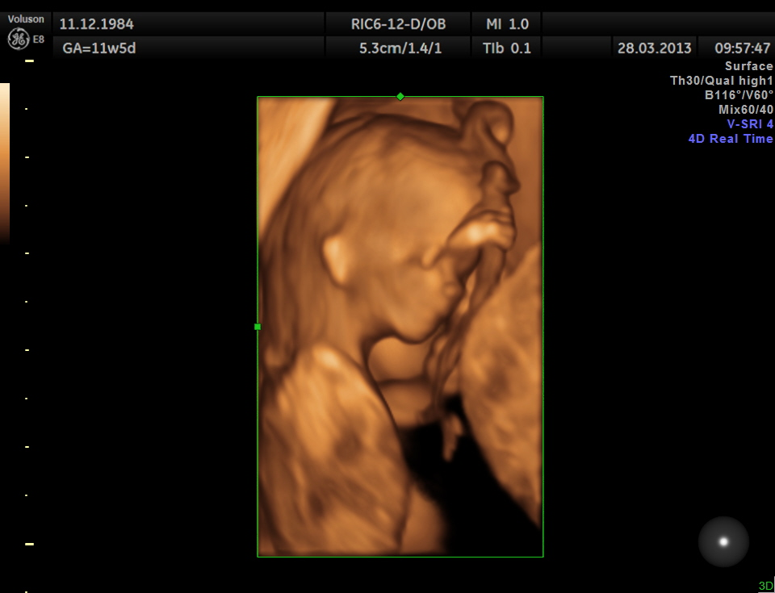
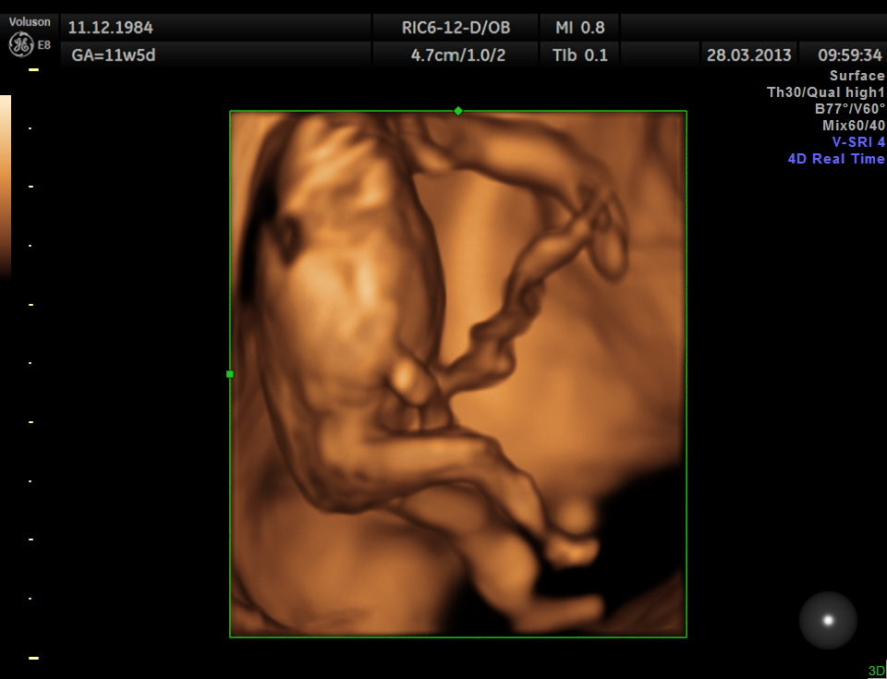
St. post
op. septi uteri
Complete uterine septum

Slide 34
2D thickness measurement is not indicator for assessment of endometrial receptivity.

Slide 35
3D volume measurement is indication for assessement of endomertial receptivity and it's energy storage.

Slide 36
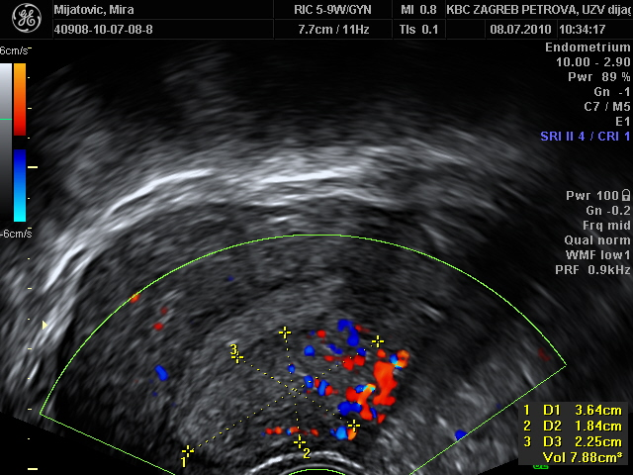
Adenomyosis uteri
2D ULTRASOUND

Slide 37
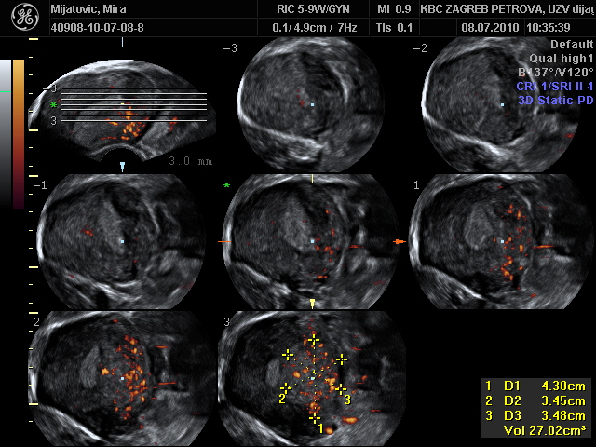
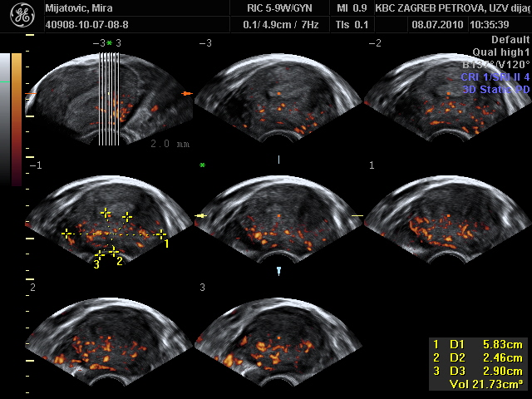
Adenomyosis
Tomographic Ultrasound Imaging – TUI
coronary
transverse
3D ULTRASOUND

Slide 38
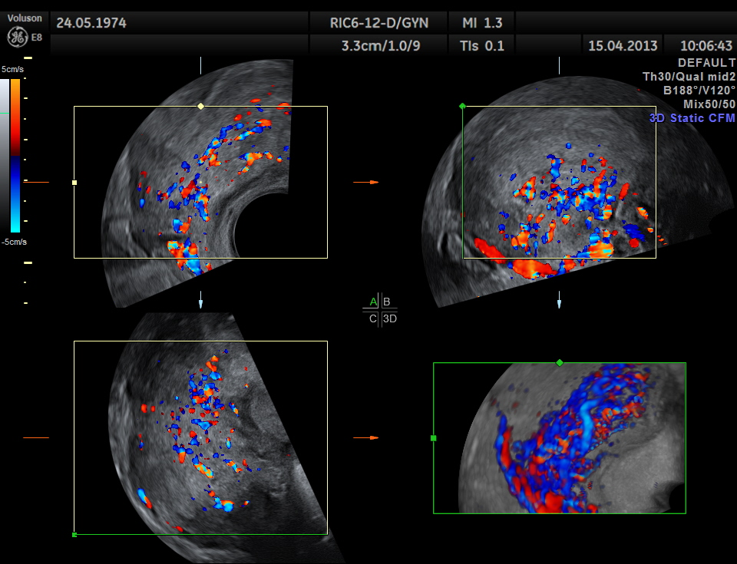
Adenomyosis
3D ULTRASOUND

Slide 39
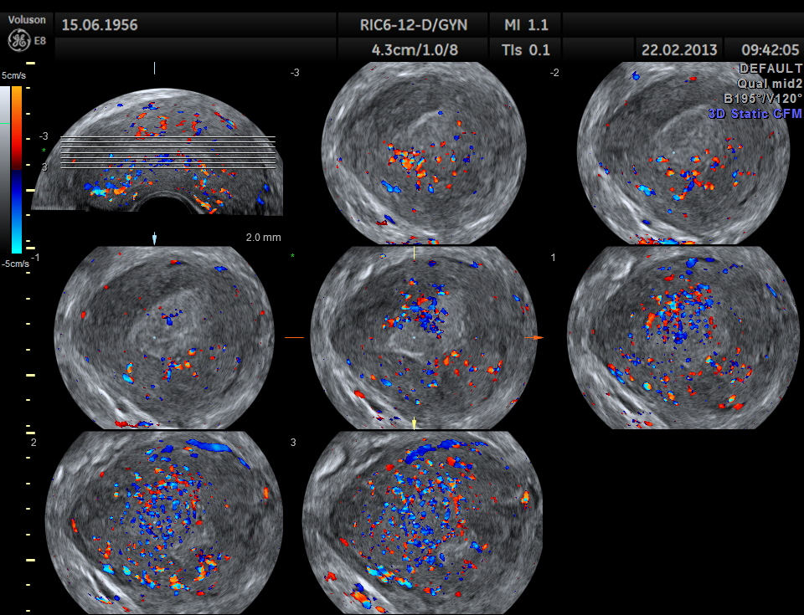
Tomographic Ultrasound Imaging – TUI
Adenomyosis

Slide 40
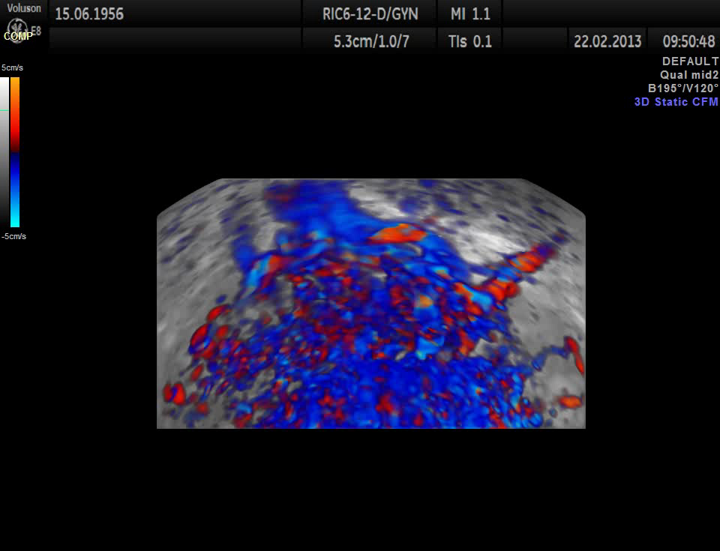
Adenomyosis

Slide 41
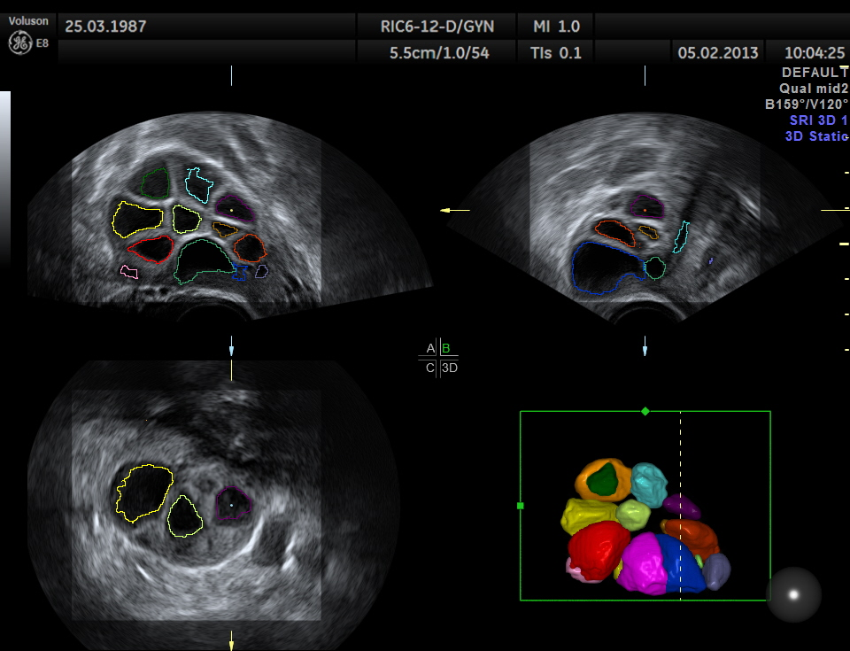
SonoAVC folikulometrija

Slide 42
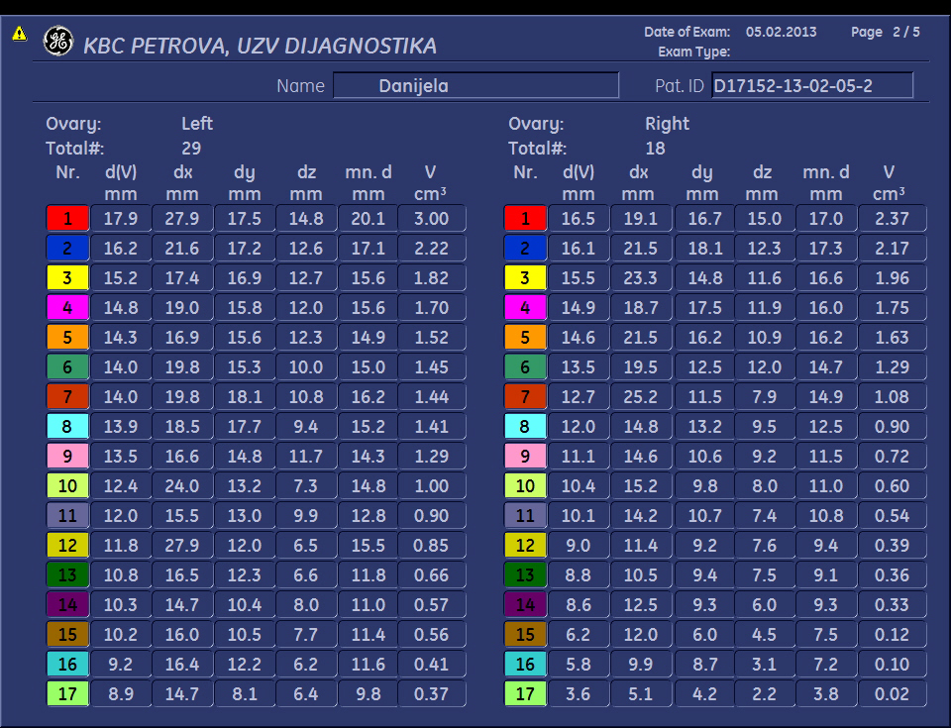
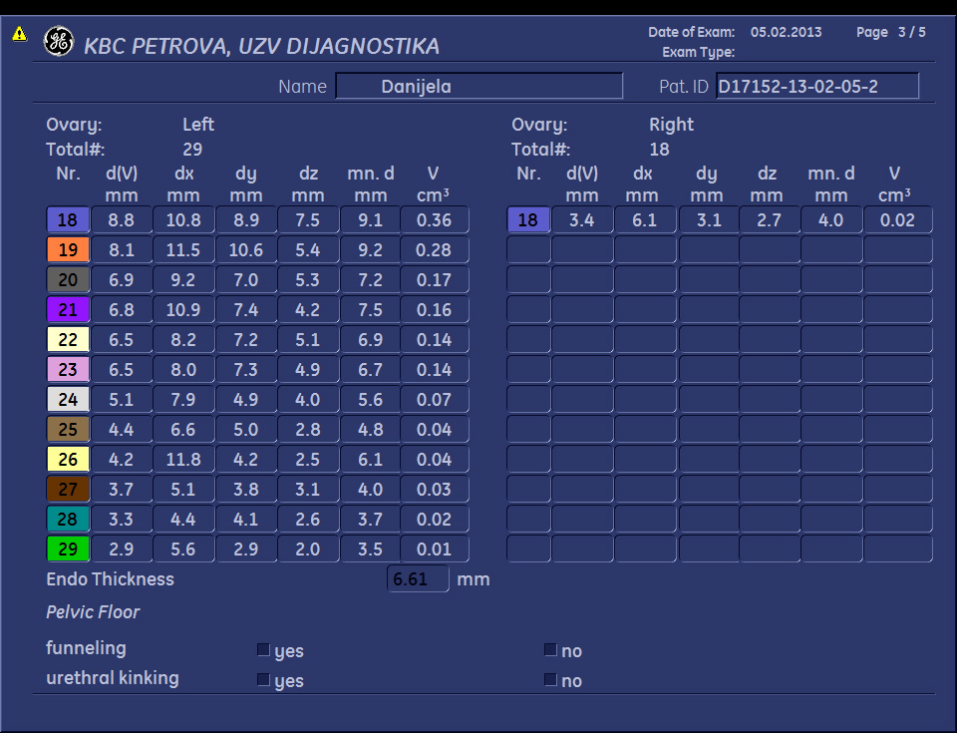
SonoAVC folikulometrija

Slide 43
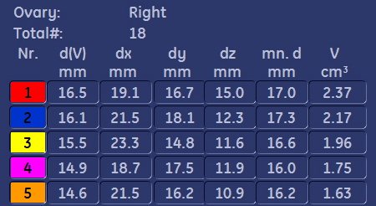
SonoAVC folikulometrija

Slide 44
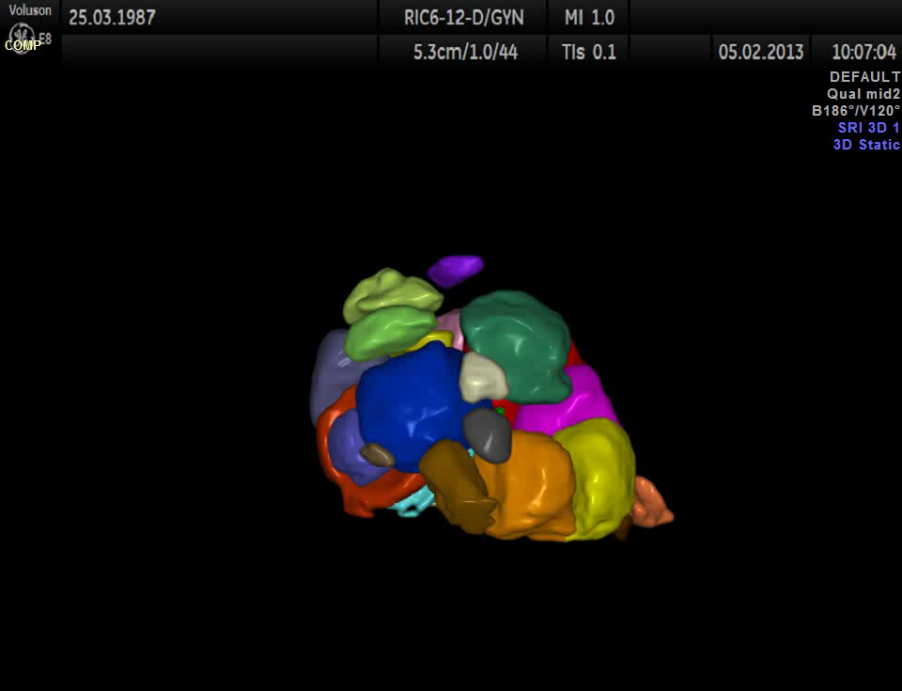
SonoAVC folikulometrija

Slide 45
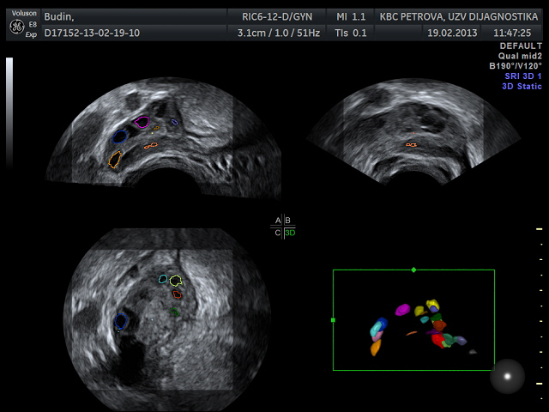
SonoAVC - PCOS

Slide 46
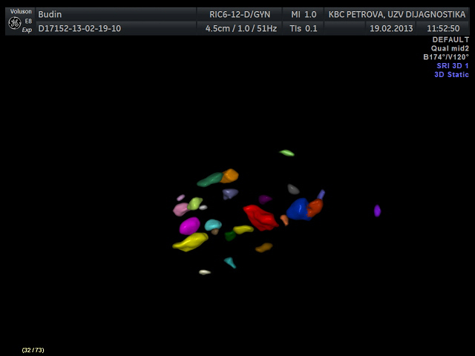
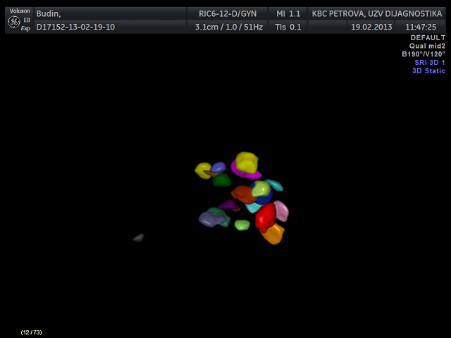
SonoAVC
PCOS

Slide 47
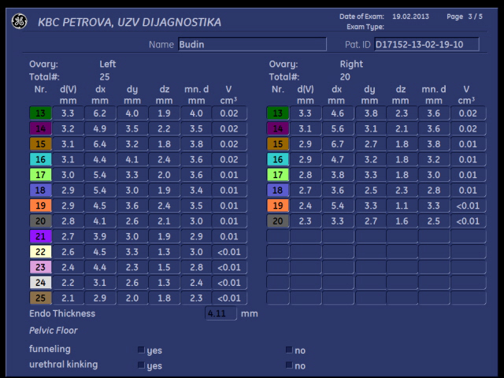
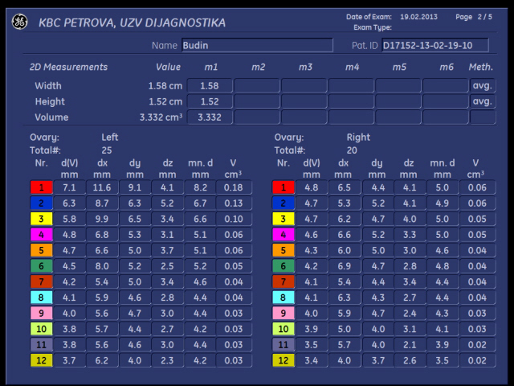
SonoAVC
PCOS

Slide 48
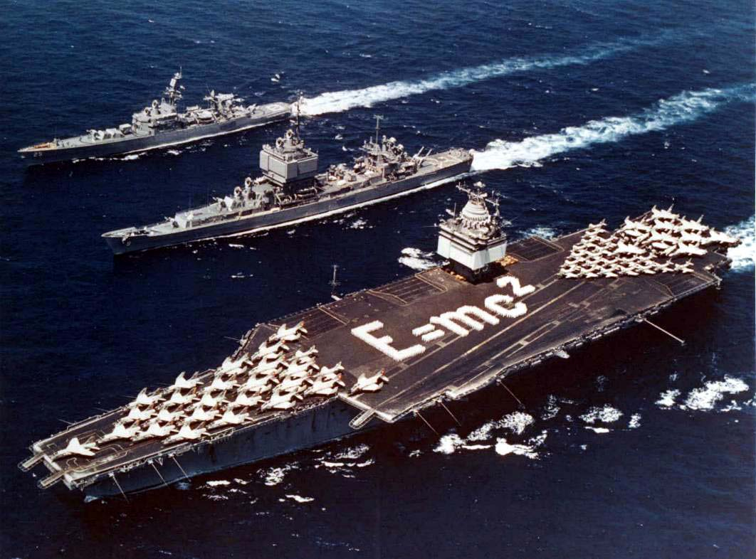
TRODIMENZIONALNI ULTRAZVUK

Slide 49

dvoDIMENZIONALNI color doppler
RESISTANCE INDEX

Slide 50

Praktična primjena trodimenzionalnog ultrazvuka u ginekologiji i opstetriciji Practical application of 3D ultrasound in gynecology and obstetrics
Opatija , Grand Hotel 4 opatijska cvijeta
3D ultrasound education - II
09. – 10. svibnja 2014.

Slide 51
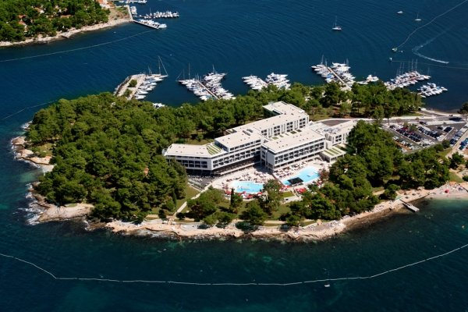
1. Hrvatski kongres o naprednom ultrazvuku u ginekologiji i opstetriciji
Nove dimenzije, nove tehnologije i novi software-i
Poreč , Hotel Parentium
09. – 12. listopada 2014.

Slide 52
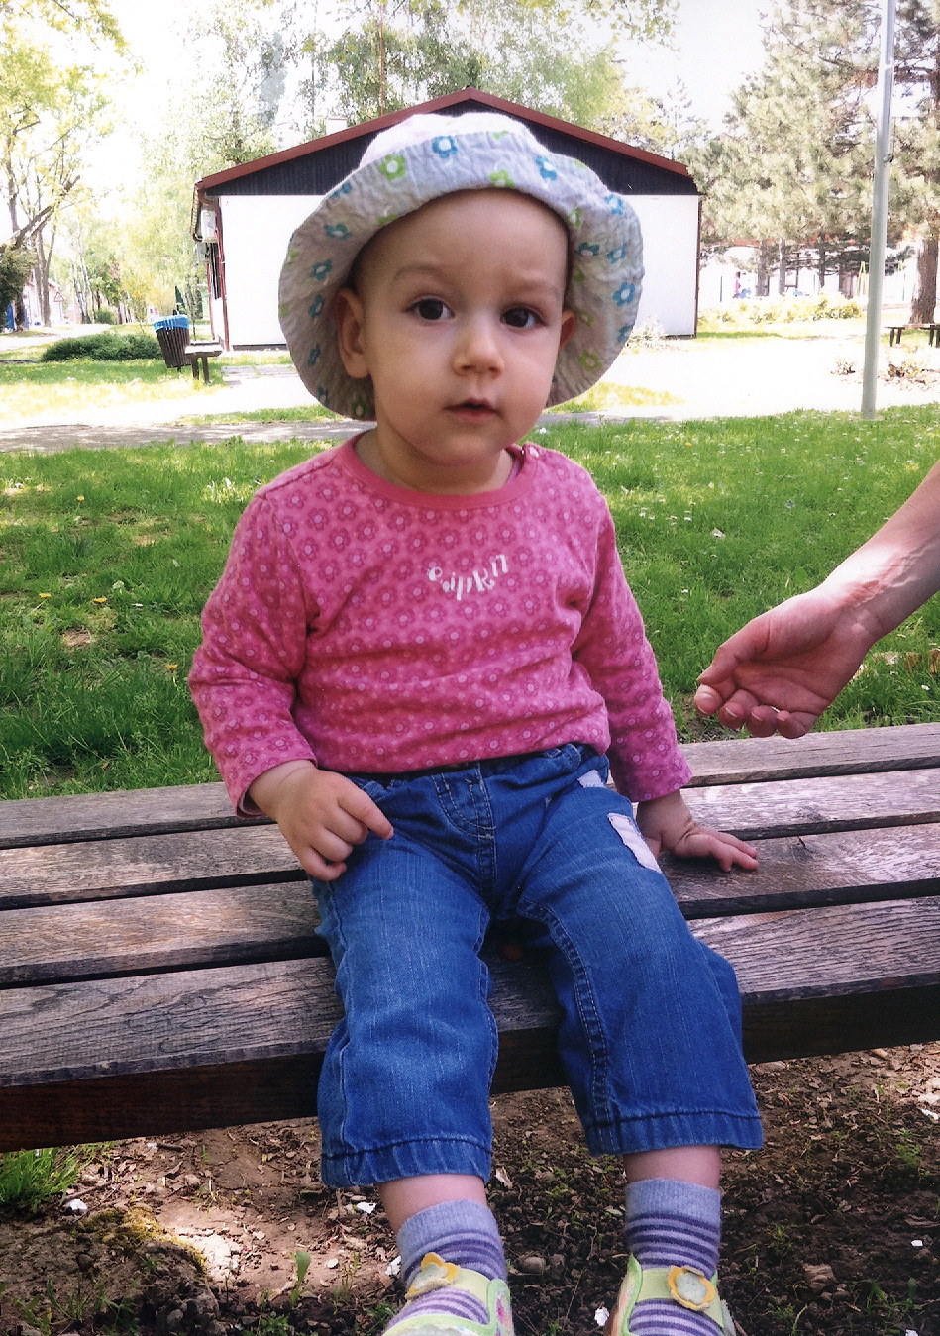
In vivo fertilization
St. post 17 x in vitro fertilization
Schrödingerova superpozicija
Heisenbergov princip neodređenosti
Kvantna fizika

